Slide 1


Paper Presentation
“Bayesian Analysis of Bug-Fixing Time using Report Data”
Presented by
Md Mynuddin
ID : ASH1825007M
NSTU, IIT
Published on
“16th ACM/IEEE International
Symposium on Empirical Software Engineering and Measurement”
Accepted: 18-23 May 2022

Slide 2
Overview
Bug-fixing is the crux of software maintenance. There was a perception that bugs were “eating the world”.
To control changes in a project and manage backlogs of issues there are several available ITS(issue tracking system), such as Bugzilla, YouTrack, and Jira.
Many studies explored information on bug reports available on different ITS such as
was this bug already registered?
who is the best person to fix this bug?
Is this a real bug?
Is this report good, and does it have enough information?
what is its priority?
How much time necessary to fix this bug
“Bayesian Analysis of Bug-Fixing Time using Report Data”

Slide 3

Problem
Finding, reporting, and fixing bugs consumes 50% of the software developer’s time.
Other studies or ITS does not offer out-of-the-box solutions like the statistical tests of the frequentist framework.
Improve the bug fixing process.
“Bayesian Analysis of Bug-Fixing Time using Report Data”

Slide 4
Proposed framework
Bayesian Framework
In this paper they show the process of using Bayesian statistics to analyze bug report data.
Evaluate the relation between the BFT
Bug report priority,
Links between reports
Code-churn size of bug-fix commits.
Their results show that the existence of links and higher code-churn values lead to BFTs that are at least twice as long.
“Bayesian Analysis of Bug-Fixing Time using Report Data”

Slide 5
Dataset Characterization
Investigation answers the following research questions:
RQ1: How does the existence of links in bug reports impacts the BFT ?
RQ2: How does the priority level of a bug report impacts the BFT ?
RQ3: How does the code-churn size of fixing commits relates to the BFT ?
The source to answer our research questions:
The dataset comprises bug report information regarding 55 open-source projects from the Apache ecosystem
All bugs reported in the dataset were identified and fixed between 2009 and 2018.
They use three category(seven features) available in the dataset
Bug Report Links
InwardIssueLinks
OutwardIssueLinks fields.
Bug Report Priority
Low
Medium, High.
Bug Report Code-Churn Size
The sum of added lines
And removed lines
“Bayesian Analysis of Bug-Fixing Time using Report Data”

Slide 6
Dataset Preprocessing
Bug Report Links
Report without links (Rnl)
Report with link (Rwl)
Bug Report Priority
Report with Low priority (Rlp)
Report with Low Medium priority (Rmp)
Report with Low High priority(Rhp)
Bug Report Code-Churn Size
with higher code-churn values (hcc)
with lower code-churn values (lcc)
“Bayesian Analysis of Bug-Fixing Time using Report Data”

Slide 7
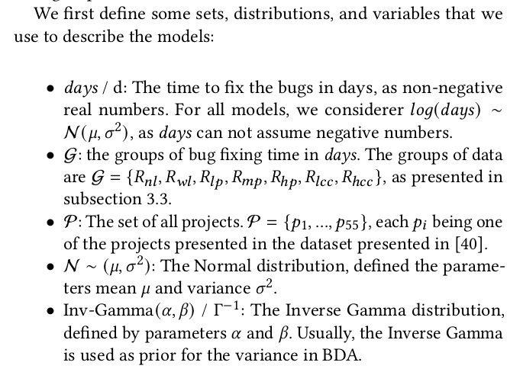
Modeling Process and Models Description
“Bayesian Analysis of Bug-Fixing Time using Report Data”

Slide 8
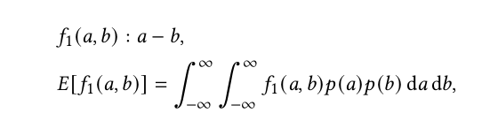
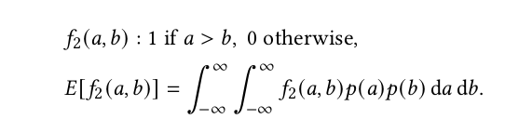
Hierarchical Models formula for Bayesian Data Analysis
“Bayesian Analysis of Bug-Fixing Time using Report Data”

Slide 9
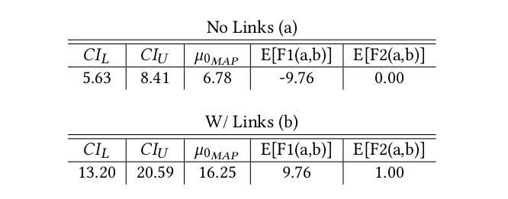
Result : RQ1
How does the existence of links in bug reports impacts the BFT ?
“Bayesian Analysis of Bug-Fixing Time using Report Data”

Slide 10
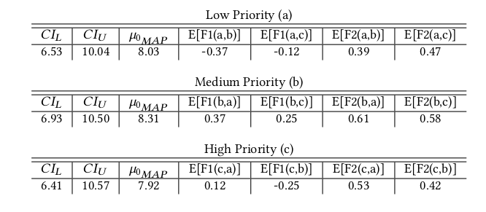
Result : RQ2
How does the priority level of a bug report impacts the BFT ?
“Bayesian Analysis of Bug-Fixing Time using Report Data”

Slide 11
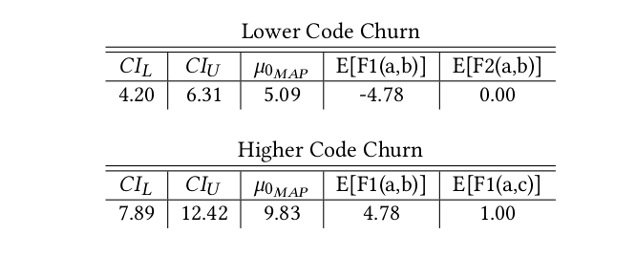
Result : RQ3
How does the code-churn size of fixing commits relates to the BFT ?
“Bayesian Analysis of Bug-Fixing Time using Report Data”

Slide 12

Future Work
As a future work, a “Regression analysis” can provide a more thoughtful view of all features presented in the used dataset, not only the ones selected in this paper, and how they relate to the BFT.
“Bayesian Analysis of Bug-Fixing Time using Report Data”

Slide 13
Conclusion
They use of Bayesian workflow to analyze bug report data and assess the influence of three features.
Evaluate the relation between the BFT and
Bug report priority.
Links between reports.
Code-churn size of bug-fix commits.
And showed evidence that priority plays no role in BFT.
In contrast, bug reports with higher values of code churn
Or bugs reports related to other bugs (with links) need at least double the time to be fixed compared to their counterparts.
“Bayesian Analysis of Bug-Fixing Time using Report Data”

Slide 14



